Slide 1
Module II MAC Sub layer
Medium Access Control (MAC) sublayer –Channel allocation problem, Multiple access protocols,
Ethernet,
Wireless LANs - 802.11,

Slide 2
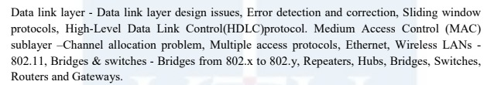

Slide 3
Medium Access Control (MAC) sublayer

Slide 4
MAC (Medium Access Control) Sub layer deals with broadcast networks and their protocols.
In any broadcast network, the key issue is how to determine who gets to use the channel when there is competition for it.
Broadcast channels are sometimes referred to as multiaccess channels or random access channels
The protocols used to determine who goes next on a multiaccess channel belong to a sublayer of the data link layer called the MAC (Medium Access Control) sublayer
MAC sublayer is especially important in LANs
central theme:
how to allocate a single broadcast channel among competing users

Slide 5
Channel Allocation Problem
Two schemes:
static and dynamic schemes
Static Channel Allocation in LANs and MANs
Traditional way of allocating a single channel, such as a telephone trunk, among multiple competing users is Frequency Division Multiplexing (FDM).
If there are N users, the bandwidth is divided into N equal-sized portions, each user being assigned one portion.
Since each user has a private frequency band, there is no interference between users.
When there is only a small and constant number of users, each of which has a heavy (buffered) load of traffic, FDM is a simple and efficient allocation mechanism

Slide 6
Problem with FDM:
When the number of senders is large and continuously varying or the traffic is bursty, FDM presents some problems.
If the spectrum is cut up into N regions and fewer than N users are currently interested in communicating, a large piece of valuable spectrum will be wasted.
If more than N users want to communicate, some of them will be denied permission for lack of bandwidth,
even if some of the users who have been assigned a frequency band hardly ever transmit or receive anything
Same problem apply to time division multiplexing (TDM).
Where each user is statically allocated every Nth time slot.
If a user does not use the allocated slot, it just lies idle.

Slide 7
Dynamic Channel Allocation
Based on 5 key assumptions:
1. Independent Traffic.
The model consists of N independent stations (e.g., computers, telephones), each with a program or user that generates frames for transmission.
The expected number of frames generated in an interval of length Δt is λΔt, where λ is a constant.
Once a frame has been generated, the station is blocked and does nothing until the frame has been successfully transmitted.
2. Single Channel.
A single channel is available for all communication.
All stations can transmit on it and all can receive from it.
The stations are assumed to be equally capable, though protocols may assign them different roles.

Slide 8
3. Observable Collisions.
If two frames are transmitted simultaneously, they overlap in time and the resulting signal is garbled. This event is called a collision.
All stations can detect that a collision has occurred. A collided frame must be transmitted again later.
4. Continuous or Slotted Time.
Time may be assumed continuous, in which case frame transmission can begin at any instant.
Alternatively, time may be slotted or divided into discrete intervals called slots.
Frame transmissions must then begin at the start of a slot.
5. Carrier Sense or No Carrier Sense.
With the carrier sense assumption, stations can tell if the channel is in use before trying to use it. No station will attempt to use the channel while it is sensed as busy.
If there is no carrier sense, stations cannot sense the channel before trying to use it. They just go ahead and transmit.

Slide 9
MULTIPLE ACCESS PROTOCOLS
Many algorithms for allocating a multiple access channel
ALOHA
Basic idea is applicable to any system in which uncoordinated users are competing for the use of a single shared channel
used ground-based radio broadcasting
two versions of ALOHA : pure and slotted.
They differ with respect to whether time is divided into discrete slots into which all frames must fit.
Pure ALOHA does not require global time synchronization;
slotted ALOHA does.

Slide 10
Pure ALOHA
Let users transmit whenever they have data to be sent.
There will be collisions and the colliding frames will be damaged.
However, due to the feedback property of broadcasting, a sender can always find out whether its frame was destroyed by listening to the channel
With a LAN, the feedback is immediate;
with a satellite, there is a delay of 270 msec before the sender knows if the transmission was successful.
If listening while transmitting is not possible for some reason, acknowledgements are needed.

Slide 11
If the frame was destroyed, the sender just waits a random amount of time and sends it again.
The waiting time must be random or the same frames will collide over and over
Systems in which multiple users share a common channel in a way that can lead to conflicts are widely known as contention systems
Whenever two frames try to occupy the channel at the same time, there will be a collision and both will be garbled
Collisions can be detected by looking at the power or pulse width of the received signal and comparing it to the transmitted signal
Experimental results shows a channel utilization of 18 percent only.

Slide 12
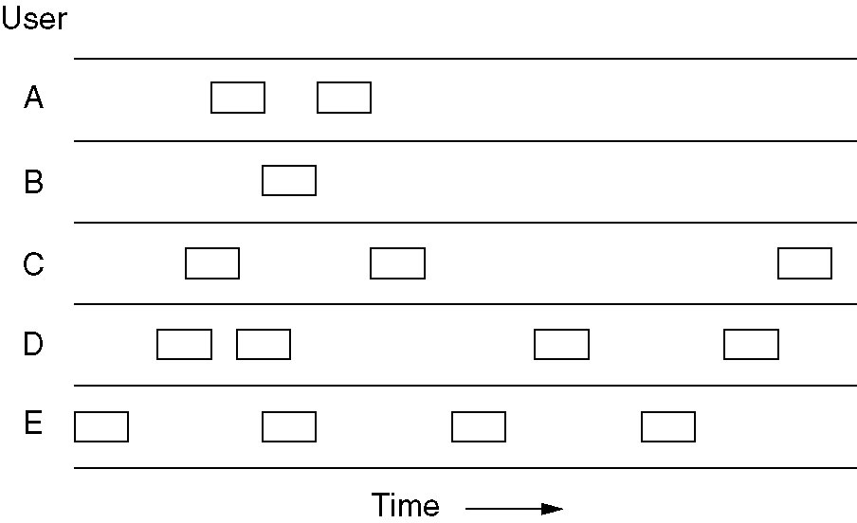
Pure ALOHA
In pure ALOHA, frames are transmitted at completely arbitrary times.

Slide 13
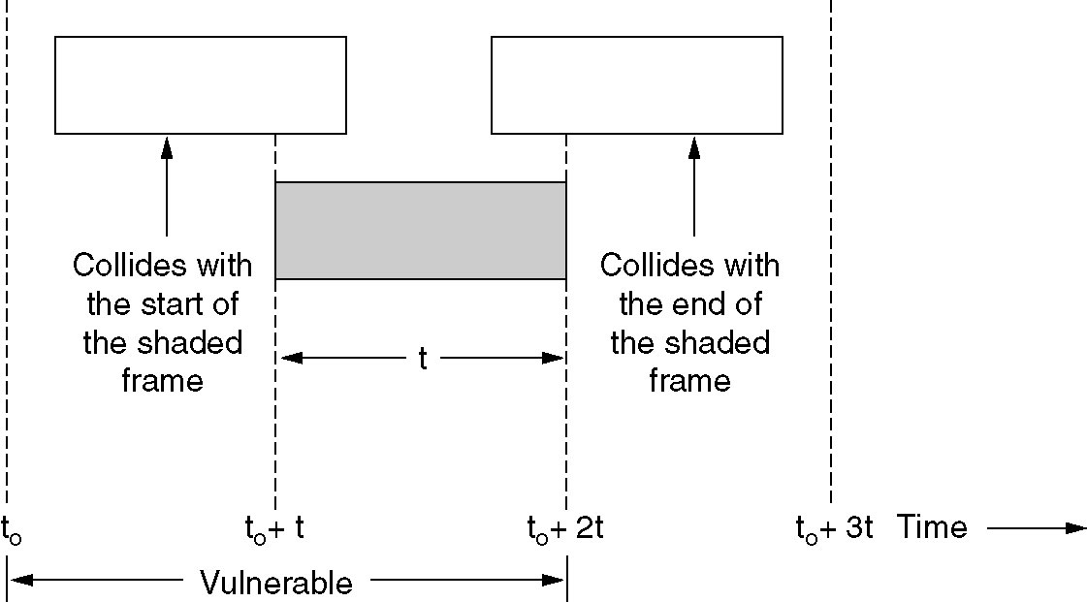
Pure ALOHA
Fig: Vulnerable period for the shaded frame.

Slide 14
Slotted ALOHA
Method for doubling the capacity of an ALOHA system
To divide time into discrete intervals, called slots, each interval corresponding to one frame.
This approach requires the users to agree on slot boundaries.
One way to achieve synchronization would be to have one special station emit a pip at the start of each interval, like a clock
A computer is not permitted to send whenever a whenever the user types a line.
Instead, it is required to wait for the beginning of the next slot
Experimental result shows using slotted aloha 37 % of the slots empty, 37 % successes, and 26 % collisions

Slide 15
Carrier Sense Multiple Access (CSMA) Protocols
Protocols in which stations listen for a carrier (i.e., a transmission) and act accordingly are called carrier sense protocols
Persistent and Nonpersistent CSMA
1-persistent CSMA
When a station has data to send, it first listens to the channel to see if anyone else is transmitting at that moment.
If the channel is busy, the station waits until it becomes idle.
When the station detects an idle channel, it transmits a frame.
If a collision occurs, the station waits a random amount of time and starts all over again.

Slide 16
The protocol is called 1-persistent because the station transmits with a probability of 1 when it finds the channel idle.
If two stations become ready in the middle of a third station’s transmission, both will wait politely until the transmission ends, and then both will begin transmitting exactly simultaneously, resulting in a collision.
The propagation delay has an important effect on collisions.
There is a chance that just after a station begins sending, another station will become ready to send and sense the channel.
If the first station’s signal has not yet reached the second one, the latter will sense an idle channel and will also begin sending, resulting in a collision

Slide 17
Nonpersistent CSMA
Before sending, a station senses the channel.
If the channel is already in use, the station does not continually sense it for the purpose of seizing it immediately upon detecting the end of the previous transmission.
Instead, it waits a random period of time and then repeats the algorithm.
Consequently, this algorithm leads to better channel utilization but longer delays than 1-persistent CSMA.

Slide 18
p-persistent CSMA
It applies to slotted channels
When a station becomes ready to send, it senses the channel.
If it is idle, it transmits with a probability p.
With a probability q = 1 - p, it defers until the next slot.
If that slot is also idle, it either transmits or defers again, with probabilities p and q.
This process is repeated until either the frame has been transmitted or another station has begun transmitting
If the station initially senses the channel busy, it waits until the next slot and applies the above algorithm

Slide 19
CSMA with Collision Detection (CSMA/CD)
Persistent and nonpersistent CSMA protocols ensure that no station begins to transmit when it senses the channel busy
Another improvement is for stations to abort their transmissions as soon as they detect a collision
If two stations sense the channel to be idle and begin transmitting simultaneously, they will both detect the collision almost immediately.
Rather than finish transmitting their frames, they should stop transmitting as soon as the collision is detected
Advs: saves time and bandwidth
widely used on LANs in the MAC sublayer

Slide 20
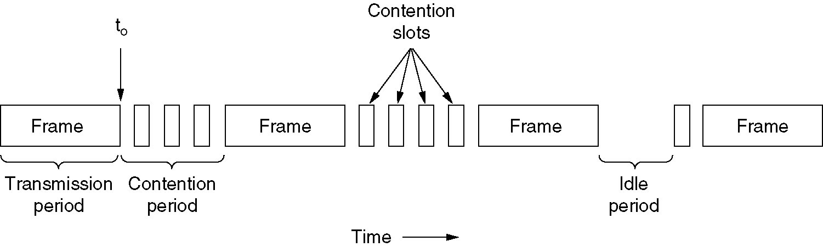
Fig: CSMA/CD can be in one of three states: contention, transmission, or idle.
idle periods occurs when all stations are quiet

Slide 21
At the point marked t0, a station has finished transmitting its frame.
Any other station having a frame to send may now attempt to do so.
If two or more stations decide to transmit simultaneously, there will be a collision.
If a station detects a collision, it aborts its transmission, waits a random period of time, and then tries again (assuming that no other station has started transmitting in the meantime).
This model consist of alternating contention and transmission periods, with idle periods occurring when all stations are quiet

Slide 22
Collision-Free Protocols
Even with CSMA/CD, collision can occur during the contention period
Especially when the cable is long and the frames are short
So collision free Protocols are required
Bit-Map Protocol & Binary Countdown
A Bit-Map Protocol
Follows the basic bit-map method
Each contention period consists of exactly N slots.
If station 0 has a frame to send, it transmits a 1 bit during the zeroth slot.
No other station is allowed to transmit during this slot.
Regardless of what station 0 does, station 1 gets the opportunity to transmit a 1 during slot 1, but only if it has a frame queued.

Slide 23
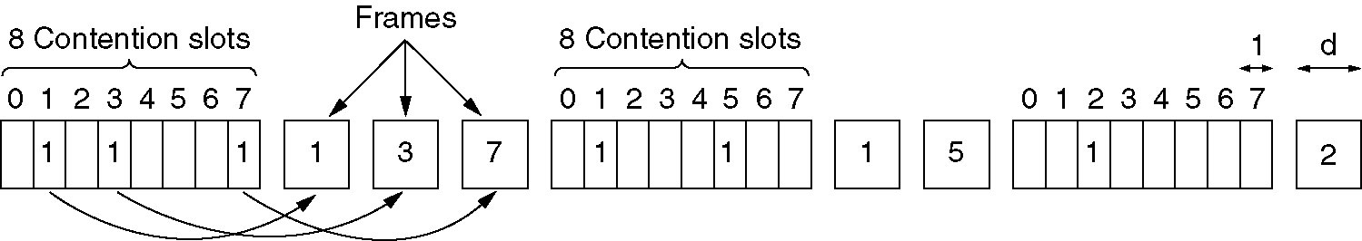
In general, station j may announce that it has a frame to send by inserting a 1 bit into slot j.
After all N slots have passed by, each station has complete knowledge of which stations wish to transmit.
At that point, they begin transmitting in numerical order
Since everyone agrees on who goes next, there will never be any collisions
Protocols in which the desire to transmit is broadcast before the actual transmission are called reservation protocols
Fig: The basic bit-map protocol.

Slide 24
Binary Countdown
problem with the basic bit-map protocol
overhead is 1 bit per station,
so it does not scale well to networks with thousands of stations
Better option is using binary station addresses
station wanting to use the channel now broadcasts its address as a binary bit string, starting with the high-order bit.
All addresses are assumed to be the same length.
The bits in each address position from different stations are BOOLEAN ORed together
So it is called binary countdown

Slide 25
To avoid conflicts, an arbitration rule must be applied:
as soon as a station sees that a high-order bit position that is 0 in its address has been overwritten with a 1, it gives up.
For eg, if stations 0010, 0100, 1001, and 1010 are all trying to get the channel, in the first bit time the stations transmit 0, 0, 1, and 1, respectively
These are ORed together to form a 1.
Stations 0010 and 0100 see the 1 and know that a higher-numbered station is competing for the channel, so they give up for the current round.
Stations 1001 and 1010 continue.
next bit is 0, and both stations continue.
next bit is 1, so station 1001 gives up.
winner is station 1010 because it has the highest address.

Slide 26
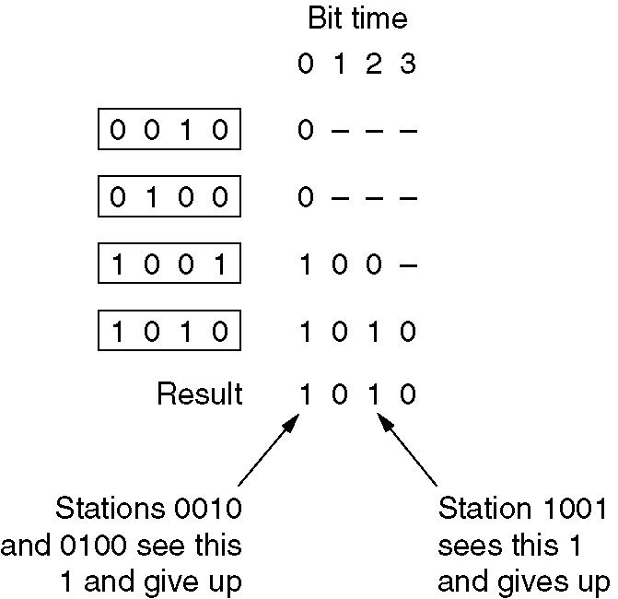
Collision-Free Protocols
After winning the bidding, it may now transmit a frame, after which another bidding cycle starts.
Fig: The binary countdown protocol.
A dash indicates silence.

Slide 27
Collision-Free Protocols
variation of binary countdown
using virtual station numbers
with the virtual station numbers from 0 up to and including the successful station being circularly permuted after each transmission,
in order to give higher priority to stations that have been silent unusually long.
For example, if stations C, H, D, A, G, B, E, F have priorities 7, 6, 5, 4, 3, 2, 1, and 0, respectively,
then a successful transmission by D puts it at the end of the list, giving a priority order of C, H, A, G, B, E, F, D.
Thus, C remains virtual station 7,
but A moves up from 4 to 5 and D drops from 5 to 0.
Station D will now only be able to acquire the channel if no other station wants it.

Slide 28
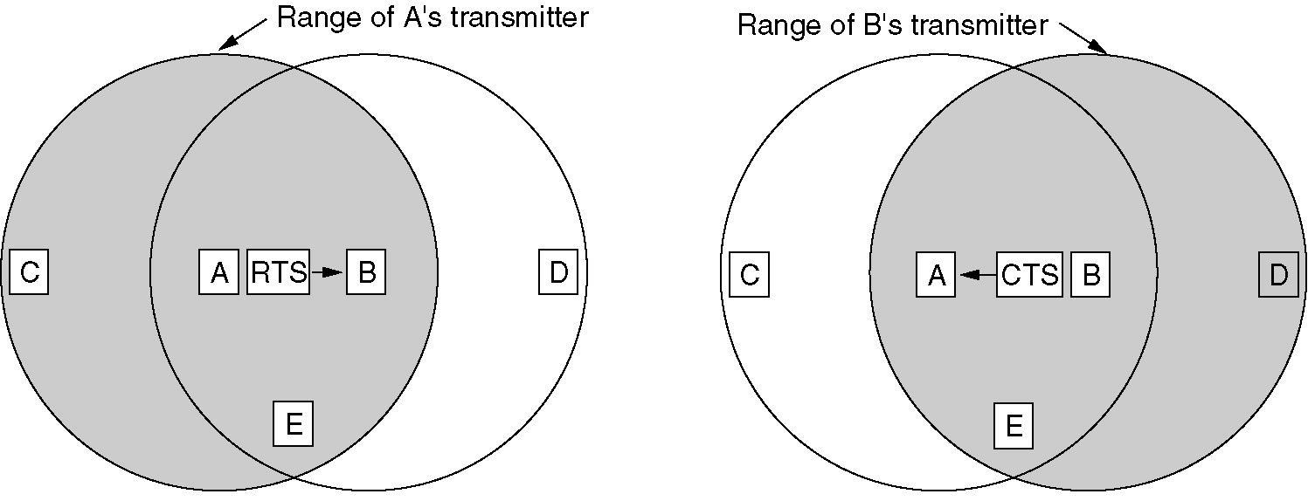
Collision Avoidance Protocol
MACA (Multiple Access with Collision Avoidance)
basic idea (early protocol for wireless LAN)
Sender is to stimulate by sending RTS (Request To Send) to the receiver into outputting a short frame, CTS (Clear To Send)
so stations nearby can detect this transmission and avoid transmitting for the duration of the upcoming (large) data frame

Slide 29
Ethernet

Slide 30
Many of the designs for personal, local, and metropolitan area networks have been standardized under the name of IEEE 802.
Two kinds of Ethernet exist:
Classic Ethernet
which solves the multiple access problem using the techniques.
Classic Ethernet is the original form and ran at rates from 3 to 10 Mbps
Switched Ethernet
Devices called switches are used to connect different computers.
Switched Ethernet is runs at 100, 1000, and 10,000 Mbps, in forms called fast Ethernet, gigabit Ethernet, and 10 gigabit Ethernet.
In practice, only switched Ethernet is used nowadays

Slide 31
Ethernet
IEEE has standardized a number of local area networks and metropolitan area networks under the name of IEEE 802
802.3 (Ethernet)
802.4 (Token bus)
802.5 (Token ring)
802.11 (wireless LAN)
802.15 (Bluetooth)
802.16 (wireless MAN)

Slide 32
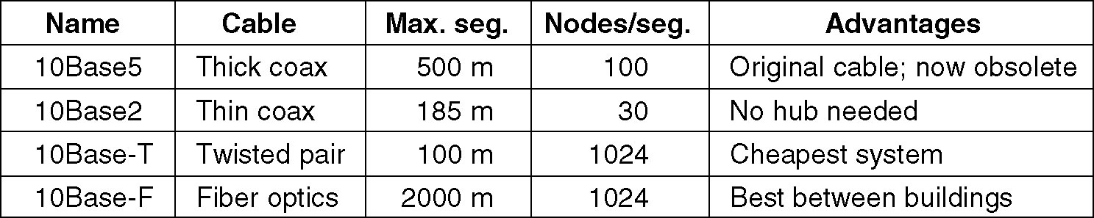
Classical Ethernet Cabling
“Ethernet” refers to the cable (the ether)
Four types of cabling are commonly used
Fig: most common kinds of Ethernet cabling

Slide 33
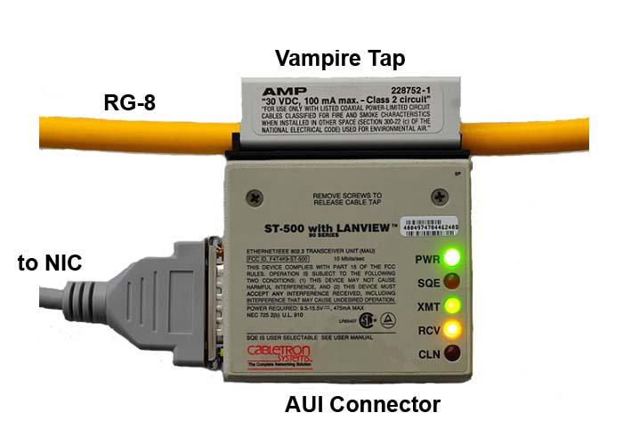
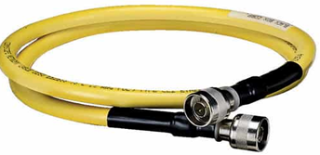
10Base5 cabling
popularly called thick Ethernet
resembles a yellow garden hose
Connections to it are generally made using vampire taps
a pin is very carefully forced halfway into the coaxial cable's core.
10Base5 means that it operates at 10 Mbps, uses baseband signaling, and can support segments of up to 500 meters.

Slide 34
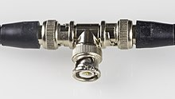
10Base2, or thin Ethernet
bends easily
Connections to it are made using industry-standard BNC connectors to form T junctions
Adv:
BNC connectors are easier to use and more reliable.
Thin Ethernet is much cheaper and easier to install
Limitation:
it can run for only 185 meters per segment, each of which can handle only 30 machines.
Major problem with 10Base5 & 10Base2
Detecting cable breaks, excessive length, bad taps, or loose connectors is difficult

Slide 35
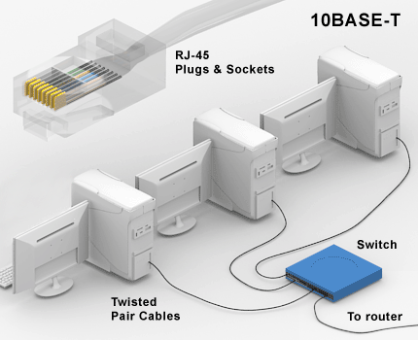
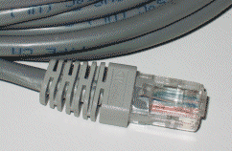
10Base-T
Problems associated with finding cable breaks introduced different kind of wiring pattern,
in which all stations have a cable running to a central hub where they are all connected electrically
these wires are telephone company twisted pairs

Slide 36
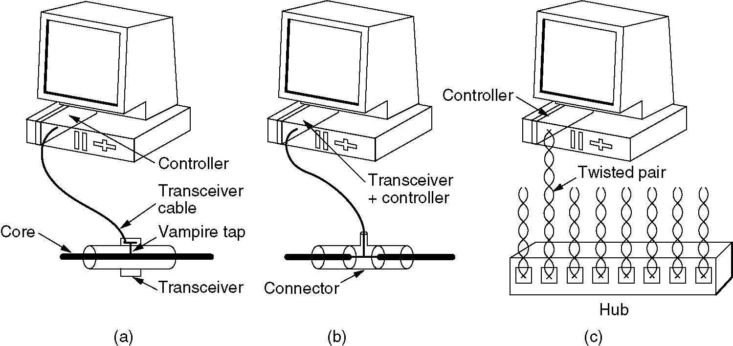
Ethernet
Three kinds of Ethernet cabling.
(a) 10Base5, (b) 10Base2, (c) 10Base-T.

Slide 37
Transceiver contains the electronics that handle carrier detection and collision detection.
When a collision is detected, the transceiver also puts a special invalid signal on the cable to ensure that all other transceivers also realize that a collision has occurred.
Disadvantage of 10Base-T
maximum cable run from the hub is only 100 meters, or 200 meters
Advantages of 10Base-T
use of existing wiring and the ease of maintenance

Slide 38
10Base-F
which uses fiber optics
Limitation:
expensive due to the cost of the connectors and terminators,
advantages:
it has excellent noise immunity
method of choice when running between buildings or widely-separated hubs.
Runs of up to kms are allowed.
It also offers good security since wiretapping fiber is much more difficult than wiretapping copper wire

Slide 39
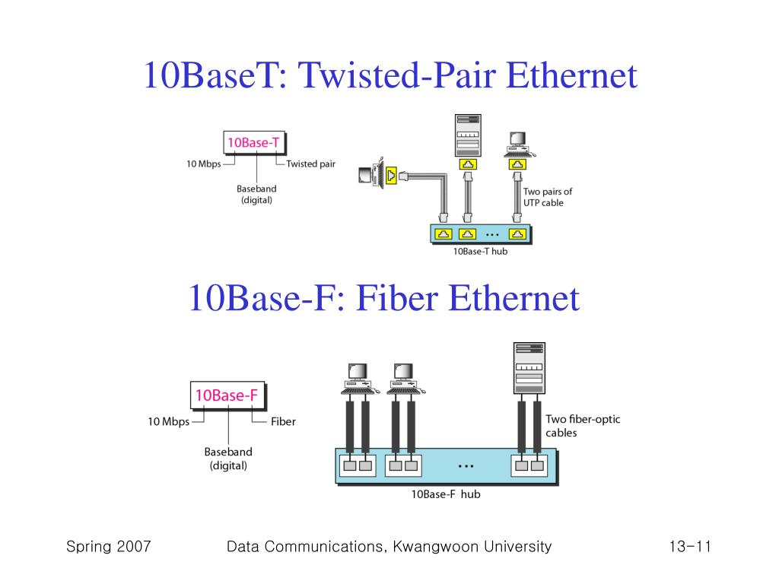

Slide 40
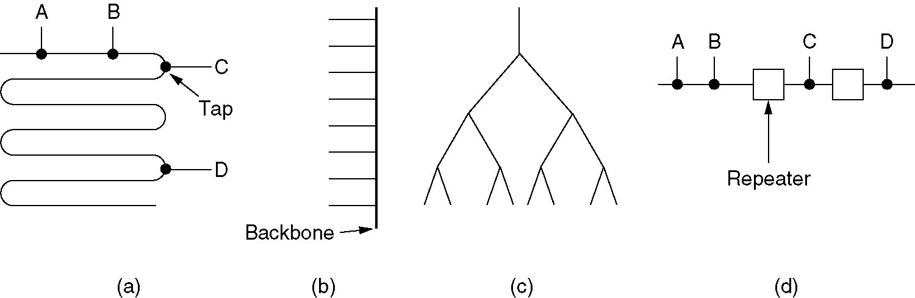
Ethernet
Cable topologies. (a) Linear, (b) Spine, (c) Tree, (d) Segmented.

Slide 41
Ethernet
Manchester Encoding - introduction
None of the versions of Ethernet uses straight binary encoding with 0 volts for a 0 bit and 5 volts for a 1 bit because it leads to ambiguities (uncertainty).
If one station sends the bit string 0001000, others might falsely interpret it as 10000000 or 01000000 because they cannot tell the difference between an idle sender (0 volts) and a 0 bit (0 volts).
This problem can be solved by using +1 volts for a 1 & -1 volts for a 0,
but there is still the problem of a receiver sampling the signal at a slightly different frequency than the sender used to generate it.

Slide 42
Ethernet
A way is needed for receivers to unambiguously determine the start, end, or middle of each bit without reference to an external clock.
Two such approaches
Manchester encoding
differential Manchester encoding.
Manchester encoding
each bit period is divided into two equal intervals.
A binary 1 bit is sent by having the voltage set high during the first interval and low in the second one.
A binary 0 is just the reverse: first low and then high.
This scheme ensures that every bit period has a transition in the middle, making it easy for the receiver to synchronize with the sender.

Slide 43
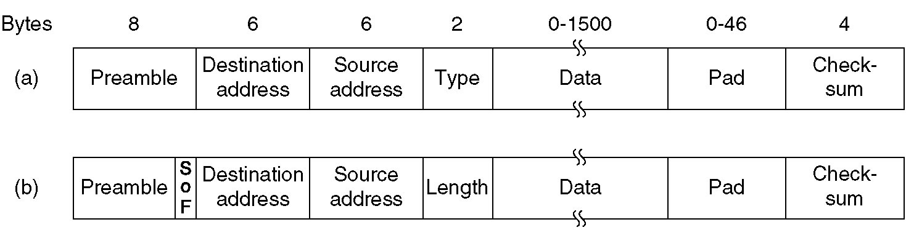
Ethernet MAC Sublayer Protocol
The format used to send frames is shown in Fig

Slide 44
Preamble
It is of 8 bytes, each containing the bit pattern 10101010 (with the exception of the last byte, in which the last 2 bits are set to 11). This last byte is called the Start of Frame delimiter for 802.3.
The last two 1 bits tell the receiver that the rest of the frame is about to start.
Next come two addresses,
one for the destination and
one for the source.
They are each 6 bytes long.
The high-order bit of the destination address is a 0 for ordinary addresses and 1 for group addresses
Sending to a group of stations is called multicast.
The address consisting of all 1 bits is reserved for broadcast

Slide 45
Type field or Length field,
Ethernet uses a Type field to tell the receiver what to do with the frame.
Multiple network-layer protocols may be in use at the same time on the same machine,
so when an Ethernet frame arrives, the kernel has to know which one to hand the frame to.
The Type field specifies which process to give the frame to
Data field
Maximum up to 1500 bytes
Minimum frame length is required
To make it easier to distinguish valid frames from garbage,
Ethernet requires that valid frames must be at least 64 bytes long, from destination address to checksum

Slide 46
Pad field
If the data portion of a frame is less than 46 bytes, the Pad field is used to fill out the frame to the minimum size.
Checksum field:
It is effectively a 32-bit hash code of the data.
If some data bits are erroneously received (due to noise on the cable), the checksum will almost certainly be wrong and the error will be detected.
The checksum algorithm is a cyclic redundancy check (CRC)
It just does error detection

Slide 47
When IEEE standardized Ethernet, the committee made two changes to the DIX format
to reduce the preamble to 7 bytes and use the last byte for a Start of Frame (SOF) delimiter, for compatibility with 802.4 and 802.5.
to change the Type field into a Length field

Slide 48
Binary Exponential Backoff Algorithm
Classic Ethernet uses the 1-persistent CSMA/CD algorithm
stations sense the medium when they have a frame to send and send the frame as soon as the medium becomes idle.
They monitor the channel for collisions as they send.
If there is a collision, they abort the transmission with a short jam signal and retransmit after a random interval.
How the random interval is determined when a collision occurs???
After a collision, time is divided into discrete slots whose length is equal to the worst-case roundtrip propagation time on the ethernet

Slide 49
After the first collision, each station waits either 0 or 1 slot times before trying again.
If two stations collide and each one picks the same random number, they will collide again.
After the second collision, each one picks either 0, 1, 2, or 3 at random and waits that number of slot times.
If a third collision occurs, then the next time the number of slots to wait is chosen at random from the interval 0 to 2³ - 1.
In general, after i collisions, a random number between 0 and 2^{i} - 1 is chosen, and that number of slots is skipped.
However, after ten collisions have been reached, the randomization interval is frozen at a maximum of 1023 slots.
After 16 collisions, the controller reports failure back to the computer.
Further recovery is up to higher layers

Slide 50
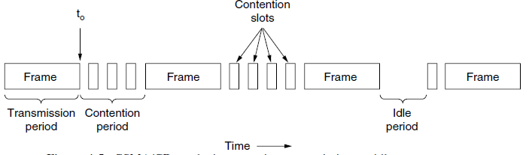

Slide 51
Advantage:
If the randomization interval for all collisions was 1023, the chance of two stations colliding for a second time would be negligible,
but the average wait after a collision would be hundreds of slot times, introducing significant delay
By having the randomization interval grow exponentially as more and more consecutive collisions occur
the algorithm ensures a low delay when only a few stations collide
but also ensures that the collision is resolved in a reasonable interval when many stations collide.

Slide 52


Ethernet Performance
If each station transmits during a contention slot with probability p, the probability A that some station acquires the channel in that slot is:
Each slot has a duration 2τ, the mean contention interval, w, is 2τ/A
If the mean frame takes P sec to transmit, when many stations have frames to send,

Slide 53

Here the maximum cable distance between any two stations enters into the performance figures.
The longer the cable, the longer the contention interval, which is why the Ethernet standard specifies a maximum cable length.
Above equation can formulated in terms of the frame length, F, the network bandwidth, B, the cable length, L, and the speed of signal propagation, c, for the optimal case of e contention slots per frame.
With P = F/B,

Slide 54
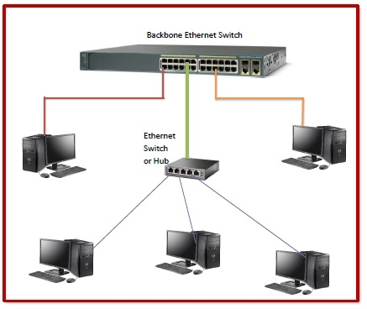
Switched Ethernet
As more and more stations are added to an Ethernet, the traffic will go up additional way to deal with increased load is switched Ethernet

Slide 55
Heart of this system is a switch containing a high-speed backplane and room for typically 4 to 32 plug-in line cards, each containing one to eight connectors.
Most often, each connector has a 10Base-T twisted pair connection to a single host computer.
When a station wants to transmit an Ethernet frame, it outputs a standard frame to the switch.
The plug-in card getting the frame may check to see if it is destined for one of the other stations connected to the same card.
If so, the frame is copied there.
If not, the frame is sent over the high-speed backplane to the destination station's card.
The backplane typically runs at many Gbps, using a proprietary protocol

Slide 56
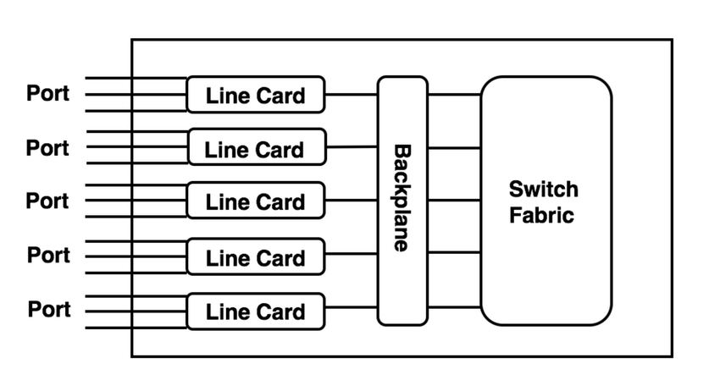

Slide 57

Fast Ethernet (802.3u)
To pump up the speed, various industry groups proposed two new ring-based optical LANs
FDDI (Fiber Distributed Data Interface)
Fibre Channel
Basic idea behind fast Ethernet was simple:
keep all the old frame formats, interfaces, and procedural rules, but just reduce the bit time from 100 nsec to 10 nsec
all fast Ethernet systems use hubs and switches
vampire taps or BNC connectors are not permitted.

Slide 58
Gigabit Ethernet (802.3z)
Goals: make Ethernet go 10 times faster yet remain backward compatible with all existing Ethernet standards
gigabit Ethernet had to
offer unacknowledged datagram service with both unicast and multicast,
use the same 48-bit addressing scheme already in use, and
maintain the same frame format, including the minimum and maximum frame sizes
All configurations are point-to-point rather than multidrop
two different modes of operation: full-duplex (normal) mode and half-duplex mode
Gigabit Ethernet supports both copper and fiber cabling

Slide 59
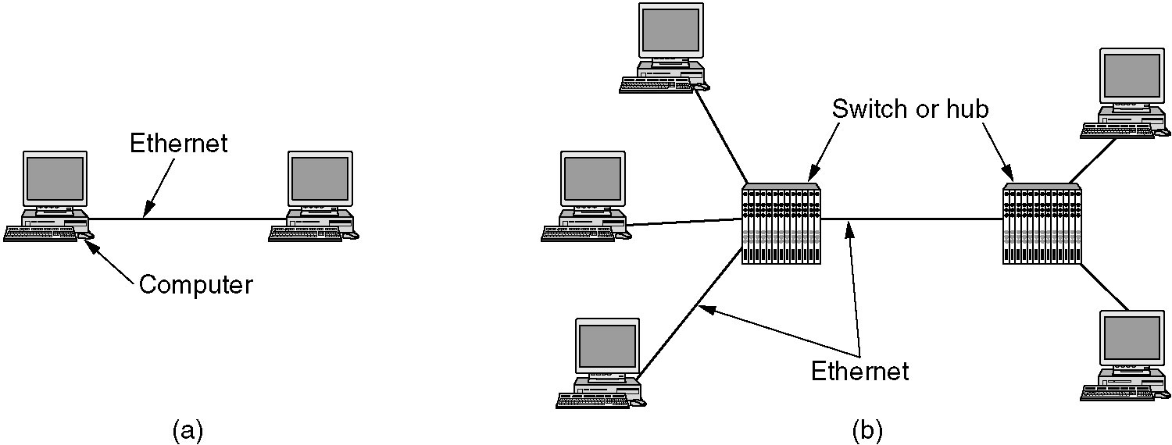
High Speed LANs - Gigabit Ethernet
Fig: (a) A two-station Ethernet. (b) A multistation Ethernet.
In both configurations each individual Ethernet cable has exactly two devices on it, no more and no fewer

Slide 60
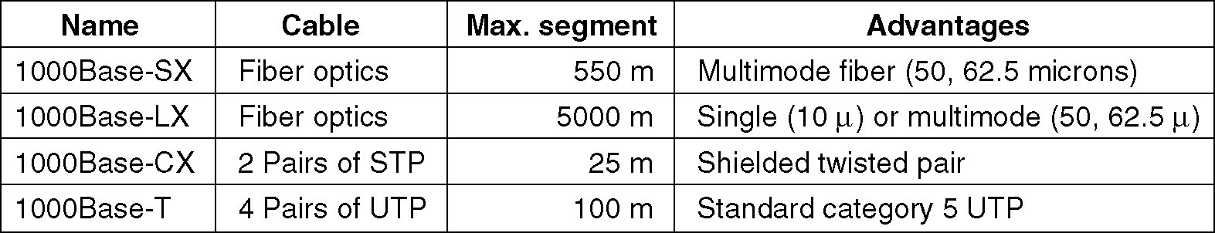
High Speed LANs - Gigabit Ethernet
Features:
carrier extension tells the hardware to add its own padding after the normal frame to extend the frame to 512 bytes
frame bursting, allows a sender to transmit a concatenated sequence of multiple frames in a single transmission
Fig: Gigabit Ethernet cabling.

Slide 61
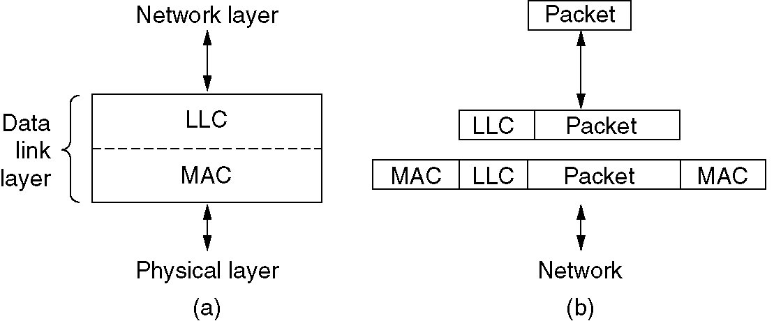
IEEE 802.2: Logical Link Control (LLC)
LLC hides the differences between the various kinds of 802 networks by providing a single format and interface to the network layer.
This format, interface, and protocol are all closely based on the HDLC protocol
LLC forms the upper half of the data link layer, with the MAC sublayer below it
Fig:
Position of LLC
(b) Protocol formats

Slide 62
Wireless LANs
Wireless LANs, 802.11 protocol stack, Physical layer, MAC Sublayer protocol, Frame structure.

Slide 63
Wireless LANs are increasingly popular, and homes, offices, cafes, libraries, airports, zoos, and other public places are being outfitted with them to connect computers, PDAs, and smart phones to the Internet.
Wireless LANs can also be used to let two or more nearby computers communicate without using the Internet.
The main wireless LAN standard is 802.11.
operate in one of two configurations
Infrastructure mode
Ad-hoc mode.

Slide 64
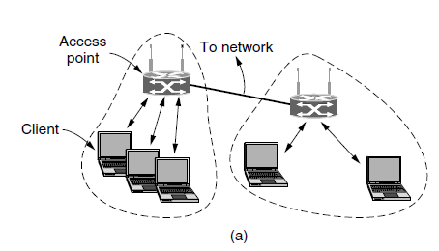
Infrastructure mode
Each client is associated with an AP (Access Point) that is in turn connected to the other network.
The client sends and receives its packets via the AP.
Several access points may be connected together, typically by a wired network called a distribution system, to form an extended 802.11 network.
clients can send frames to other clients via their APs.

Slide 65
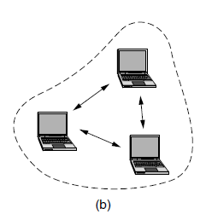
Ad hoc network
This mode is a collection of computers that are associated so that they can directly send frames to each other.
There is no access point.
Since Internet access is the killer application for wireless, ad hoc networks are not very popular

Slide 66
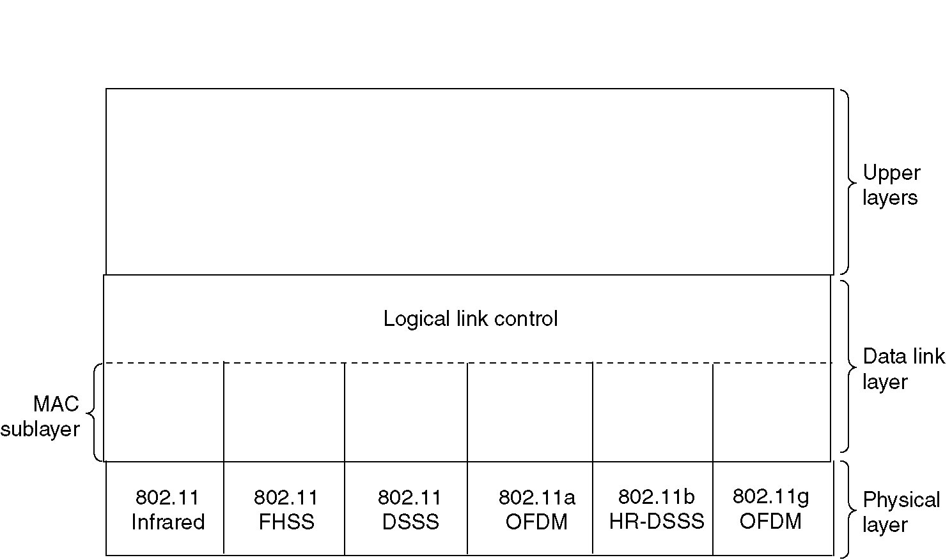
802.11 protocol stack
All the 802 protocols, including 802.11 and Ethernet, have a certain commonality of structure.
A partial view of the 802.11 protocol stack is given

Slide 67
The stack is the same for clients and APs.
Data link layer in all the 802 protocols is split into two or more sublayers.
In 802.11, the MAC (Medium Access Control) sublayer determines how the channel is allocated, that is, who gets to transmit next.
Above it is the LLC (Logical Link Control) sublayer, whose job it is to hide the differences between the different 802 variants and make them indistinguishable as far as the network layer is concerned.
The LLC is a glue layer that identifies the protocol (e.g., IP) that is carried within an 802.11 frame.

Slide 68
The 802.11 Physical Layer
The 1997 802.11 standard specifies three groups of transmission techniques allowed in the physical layer.
Infrared method (1 technique )
Short – range radio method (2 techniques)
Higher bandwidth method(2+1 techniques)
Each of the five permitted transmission techniques makes it possible to send a MAC frame from one station to another.
They differ, however, in the technology used and speeds achievable.

Slide 69
The 802.11 Physical Layer
1) Infrared method
This method uses much the same technology as television remote controls do.
The infrared option uses diffused (i.e., not line of sight) transmission at 0.85 or 0.95 microns.
Two speeds are permitted: 1 Mbps and 2 Mbps

Slide 70
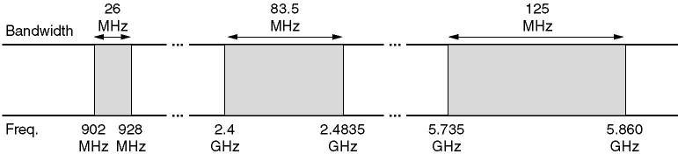
The 802.11 Physical Layer
Short – range radio method (2 techniques )
FHSS (Frequency Hopping Spread Spectrum) uses 79 channels, each 1-MHz wide, starting at the low end of the 2.4-GHz ISM (Industrial, Scientific, Medical) band.
A pseudorandom number generator is used to produce the sequence of frequencies hopped to.

Slide 71
The 802.11 Physical Layer
2) Short – range radio method (2 techniques )
b) DSSS (Direct Sequence Spread Spectrum), is also restricted to 1 or 2 Mbps.
The scheme used has some similarities to the CDMA (Code Division Multiple Access) system.
Each bit is transmitted as 11 chips, using what is called a Barker Sequence.

Slide 72
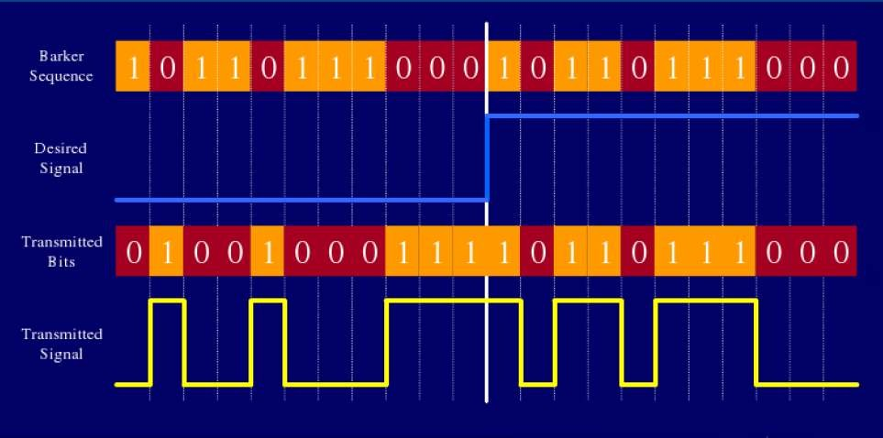
DSSS (Direct Sequence Spread Spectrum)

Slide 73
The 802.11 Physical Layer
2) Short – range radio method (2 techniques )
Both of these (FHSS and DSSS) use a part of the spectrum that does not require licensing (the 2.4-GHz ISM band).
Radio-controlled garage door openers also use this piece of the spectrum, so your notebook computer may find itself in competition with your garage door.

Slide 74
The 802.11 Physical Layer
Higher bandwidth method (3 techniques )
802.11a, OFDM (Orthogonal Frequency Division Multiplexing) is used to deliver up to 54 Mbps in the wider 5 GHz ISM band.
Splitting the signal into many narrow bands has some key advantages over using a single wide band, including better immunity to narrowband interference

Slide 75
The 802.11 Physical Layer
3) Higher bandwidth method (3 techniques )
b) 802.11b, HR-DSSS (High Rate Direct Sequence Spread Spectrum) uses 11 million chips/sec to achieve 11 Mbps in the 2.4- GHz band.
Although 802.11b is slower than 802.11a, its range is about 7 times greater, which is more important in many situations.

Slide 76
The 802.11 Physical Layer
3) Higher bandwidth method (3 techniques )
c) 802.11g is an enhanced version of 802.11b.
It uses the OFDM (Orthogonal Frequency Division Multiplexing) modulation method of 802.11a but operates in the narrow 2.4-GHz ISM band along with 802.11b.
In theory it can operate at up to 54 Mbps. It is not yet clear whether this speed will be realized in practice.

Slide 77
The 802.11 MAC Sublayer Protocol
The 802.11 MAC sublayer protocol is quite different from that of Ethernet, due to two factors that are fundamental to wireless communication.
First, radios are nearly always half duplex, meaning that they cannot transmit and listen for noise bursts at the same time on a single frequency.
The received signal can easily be a million times weaker than the transmitted signal, so it cannot be heard at the same time.
With Ethernet, a station just waits until the ether goes silent and then starts transmitting.
If it does not receive a noise burst back while transmitting the first 64 bytes, the frame has almost assuredly been delivered correctly.
With wireless, this collision detection mechanism does not work

Slide 78
802.11 tries to avoid collisions with a protocol called CSMA/CA (CSMA with Collision Avoidance).
This protocol is conceptually similar to Ethernet’s CSMA/CD, with channel sensing before sending and exponential back off after collisions.
However, a station that has a frame to send starts with a random backoff.
It does not wait for a collision. The number of slots to backoff is chosen in the range 0 to, say, 15 in the case of the OFDM physical layer.
The station waits until the channel is idle, by sensing that there is no signal for a short period of time, and counts down idle slots, pausing when frames are sent. It sends its frame when the counter reaches 0.
If the frame gets through, the destination immediately sends a short acknowledgement.

Slide 79
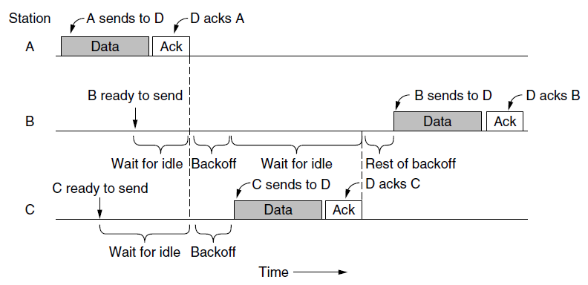
Lack of an acknowledgement is inferred to indicate an error, whether a collision or otherwise.
The sender doubles the backoff period and tries again, continuing with exponential backoff as in Ethernet until the frame has been successfully transmitted or the maximum number of retransmissions has been reached.

Slide 80
An example timeline is shown in Fig.
Station A is the first to send a frame.
While A is sending, stations B and C become ready to send.
They see that the channel is busy and wait for it to become idle.
Shortly after A receives an acknowledgement, the channel goes idle.
However, rather than sending a frame right away and colliding, B and C both perform a backoff.
C picks a short backoff, and thus sends first.
B pauses its countdown while it senses that C is using the channel, and resumes after C has received an acknowledgement.
B soon completes its backoff and sends its frame.

Slide 81
Compared to Ethernet, there are two main differences.
Starting backoffs early helps to avoid collisions.
This avoidance is worthwhile because collisions are expensive, as the entire frame is transmitted even if one occurs.
Acknowledgements are used to infer collisions because collisions cannot be detected.
This mode of operation is called DCF (Distributed Coordination Function) because each station acts independently, without any kind of central control.

Slide 82
One problem is that the transmission ranges of different stations may be different.
With a wire, all stations can hear each other.
With the complexities of RF propagation this situation does not hold for wireless stations.
Since not all stations are within radio range of each other, transmissions going on in one part of a cell may not be received elsewhere in the same cell.

Slide 83
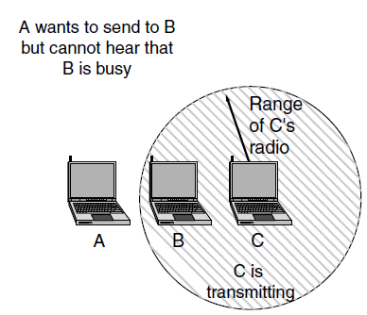
Leads to the hidden terminal problem as in Fig.
Here, station C is transmitting to station B.
If A senses the channel, it will not hear anything and will falsely conclude that it may now start transmitting to B.
This decision leads to a collision

Slide 84
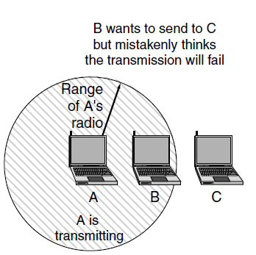
The inverse situation is the exposed terminal problem, illustrated in Fig.
Here, B wants to send to C, so it listens to the channel.
When it hears a transmission, it falsely concludes that it may not send to C, even though A may in fact be transmitting to D (not shown).
This decision wastes a transmission opportunity.

Slide 85
To reduce ambiguities about which station is sending, 802.11 defines channel sensing to consist of both physical sensing and virtual sensing.
Physical sensing simply checks the medium to see if there is a valid signal.
With virtual sensing, each station keeps a logical record of when the channel is in use by tracking the NAV (Network Allocation Vector).

Slide 86
Each frame carries a NAV field that says how long the sequence of which this frame is part will take to complete.
Stations that overhear this frame know that the channel will be busy for the period indicated by the NAV, regardless of whether they can sense a physical signal.
For example, the NAV of a data frame includes the time needed to send an acknowledgement.
All stations that hear the data frame will defer during the acknowledgement period, whether or not they can hear the acknowledgement

Slide 87
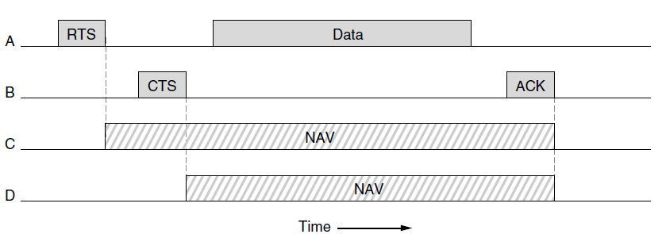
An optional RTS/CTS mechanism uses the NAV to prevent terminals from sending frames at the same time as hidden terminals.
Here, A wants to send to B. C is a station within range of A
D is a station within range of B but not within range of A.

Slide 88
The protocol starts when A decides it wants to send data to B.
A begins by sending an RTS frame to B to request permission to send it a frame.
If B receives this request, it answers with a CTS frame to indicate that the channel is clear to send.
Upon receipt of the CTS, A sends its frame and starts an ACK timer.
Upon correct receipt of the data frame, B responds with an ACK frame, completing the exchange.
If A’s ACK timer expires before the ACK gets back to it, it is treated as a collision and the whole protocol is run again after a backoff.

Slide 89
Now let us consider this exchange from the viewpoints of C and D.
C is within range of A, so it may receive the RTS frame.
If it does, it realizes that someone is going to send data soon.
From the information provided in the RTS request, it can estimate how long the sequence will take, including the final ACK.
So, it desists from transmitting anything until the exchange is completed.
It does so by updating its record of the NAV to indicate that the channel is busy.
D does not hear the RTS, but it does hear the CTS, so it also updates its NAV.
Note that the NAV signals are not transmitted; they are just internal reminders to keep quiet for a certain period of time.

Slide 90
However, while RTS/CTS sounds good in theory, it is one of those designs that has proved to be of little value in practice.
CSMA/CA with physical and virtual sensing is the core of the 802.11 protocol.

Slide 91
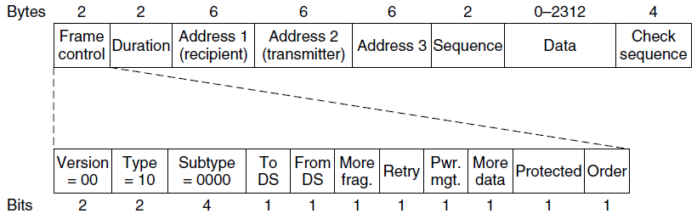
The 802.11 Frame Structure
Frame Control field- made up of 11 subfields.
Protocol version, set to 00.which allows future versions of the protocol to operate at the same time in the same cell
Type (data, control, or management) and Subtype fields (e.g., RTS or CTS).
To DS and From DS bits indicate the frame is going to or coming from the the network connected to the APs, which is called thedistribution system (e.g., Ethernet).

Slide 92
The More fragments bit means that more fragments will follow.
The Retry bit marks a retransmission of a frame sent earlier.
The Power management bit indicates that the sender is going into power-save mode.
The More data bit indicates that the sender has additional frames for the receiver.
The Protected Frame bit indicates that the frame body has been encrypted for security.
Finally, the Order bit tells the receiver that the higher layer expects the sequence of frames to arrive strictly in order.

Slide 93
The Duration field, tells how long the frame and its acknowledgement will occupy the channel, measured in microseconds.
Next come addresses.
Data frames sent to or from an AP have three addresses,
The first address is the receiver,
Second address is the transmitter.
Third address - the AP is simply a relay point for frames as they travel between a client and another point on the network, perhaps a distant client or a portal to the Internet. The third address gives this distant endpoint.

Slide 94
The Sequence field numbers frames so that duplicates can be detected. Of the 16 bits available, 4 identify the fragment and 12 carry a number that is advanced with each new transmission.
The Data field contains the payload, up to 2312
bytes.
Frame check sequence, has the 32-bit CRC

Slide 95
DATA LINK LAYER SWITCHING
Many organizations have multiple LANs and wish to connect them.
LANs can be connected by devices called bridges, which operate in the data link layer.
Bridges examine the data layer link addresses to do routing.
Since they are not supposed to examine the payload field of the frames they route, they can transport IPv4 (used in the Internet now), IPv6 (will be used in the Internet in the future), AppleTalk, ATM, OSI, or any other kinds of packets.
In contrast, routers examine the addresses in packets and route based on them.
95

Slide 96
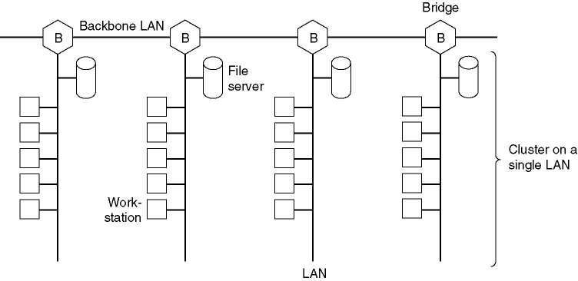
Data Link Layer Switching
Multiple LANs connected by a backbone to handle a total load higher than the capacity of a single LAN.
96

Slide 97
Data Link Layer Switching
The technology of bridges
Bridges from 802.x to 802.y
Local Internetworking
Spanning Tree Bridges
Remote Bridges
Repeaters, Hubs, Bridges, Switches, Routers, Gateways
Virtual LANs
97

Slide 98
Bridges from 802.x to 802.y
Following figure illustrates the operation of a simple two-port bridge.
Host A on a wireless (802.11) LAN has a packet to send to a fixed host, B, on an (802.3) Ethernet to which the wireless LAN is connected.
Note that a bridge connecting k different LANs will have k different MAC sublayers and k different physical layers, one for each type.
98

Slide 99
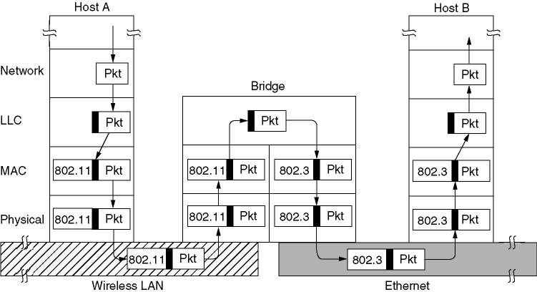
Operation of a LAN bridge from 802.11 to 802.3.
99

Slide 100
Bridges from 802.x to 802.y
There are many difficulties that one encounters when trying to build a bridge between the various 802 LANs (and MANs)
Each of the LANs uses a different frame format
100

Slide 101
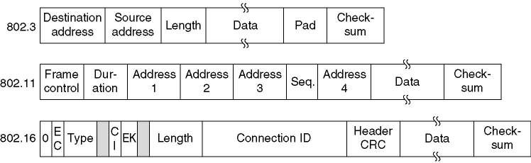
The IEEE 802 frame formats.
The drawing is not to scale.
101

Slide 102
Some problems are :
The first is any copying between different LANs requires reformatting
The second is data rate problem
The third is different 802 LANs have different maximum frame lengths.
Another is the security problem
Last is quality of service.
102

Slide 103
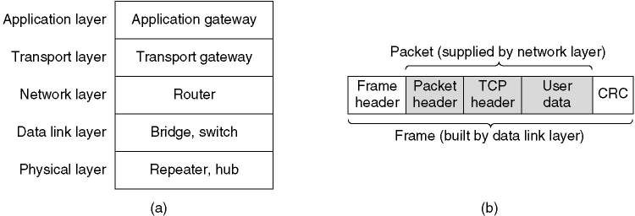
Repeaters, Hubs, Bridges, Switches, Routers and Gateways
These devices operate in different layers.
Which device is in which layer.
(b) Frames, packets, and headers.

Slide 104
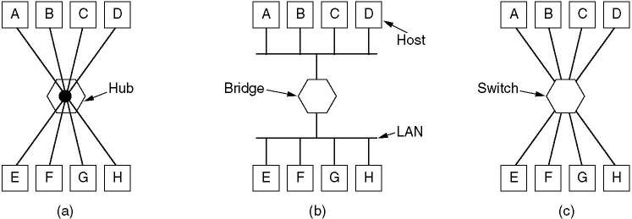
(a) A hub (b) A bridge. (c) a switch.
104

Slide 105
Repeaters are analog devices that are connected to two cable segments. A signal appearing on one of them is amplified and put out on the other.
Hubs have a number of inputs lines that it joins electrically. Frames arriving on any of the lines are sent out on all the others.
Bridges connect two or more LANs. When a frame arrives, software in the bridge extracts the destination address from the frame header and looks it up in a table to see where to send the frame.
Switches are similar to bridges in that both route on frame addresses. The main difference is that a switch is most often used to connect individual computers.
105

Slide 106
Routers are different from all of the above.
When a packet comes into a router, the frame header and trailer are stripped off and the packet located in the frame’s payload field is passed to the routing software.
This software uses the packet header to choose an output line.
106

Slide 107
Transport gateways connect two computers that use different connection – oriented transport protocols. The transport gateway can copy the packets from one connection to the other, reformatting them as need be.
Application gateways understand the format and contents of the data and translate messages from one format to another.

Slide 108
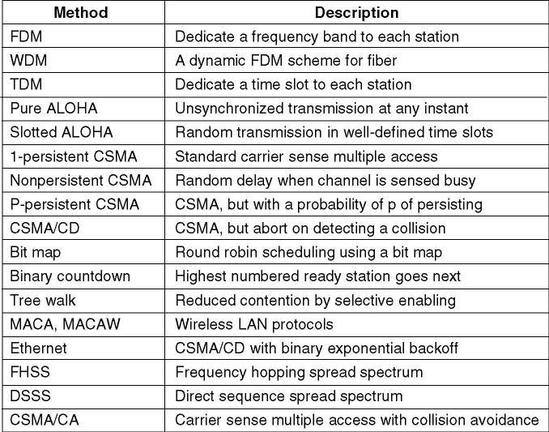
Summary

Slide 109
1. Multiple access protocols 2. The data received by the receiver is 10101101110.state whether the received code word is correct or wrong .If wrong locate the bit having error.(Assume even parity is used) 3. What is the remainder obtained by dividing x7 + x5 + 1 by the generator polynomial x³ + 1?

Slide 110
https://www.geeksforgeeks.org/hamming-code-in-computer-network/

Slide 111
7,1013,18,19,20,21,35,36,42,43 Joseph zephan joe jomy

Slide 112
